Slide 1
Component based Design

Slide 2
Subsystem Decomposition
Student Registration System
Data Entry Validation
Transaction Verification
Report Generation
Data Updation
Student Data Validation
Course Data Validation
Transaction Checks
Addition Modules
Deletion Module
Logical component: business components, logic layer, no explicit physical run-time equivalent
Physical component: database server, explicit run-time equivalent

Slide 3
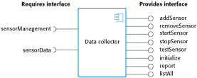
A Component with Interfaces

Slide 4
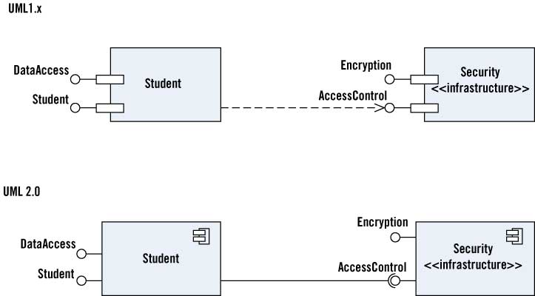
Component Diagram
http://www.drdobbs.com/web-development/whats-new-in-uml-2/184415097

Slide 5
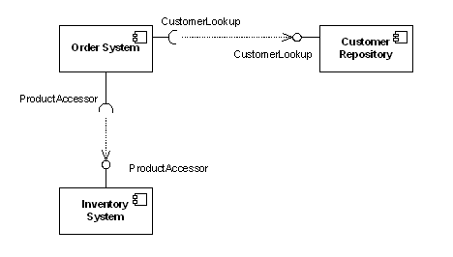
Example

Slide 6
Accident Management System (AMS)
Consider an accident management system where field officers (such as a police officer or a fire fighter) have access to a wireless computer that enables them to interact with a dispatcher. The dispatcher in turn can visualize the current status of all its resources, such as police cars or trucks, on a computer screen and dispatch a resource by issuing commands from a workstation. In this example, field officer and dispatcher can be modeled as actors.

Slide 7
AMS Decomposition
Dispatcher Interface Subsystem: user interface for Dispatcher
Field Officer Interface Subsystem: user interface for Field Officer
Incident Management Subsystem: creation, modification, and storage of Incidents
Resource Management Subsystem: tracking available resources (s.a. Fire Trucks, Ambulances)
Map Management Subsystem: depicting Maps and Locations
Notification Subsystem: implementing the communication between Field Officer terminals and Dispatcher stations

Slide 8
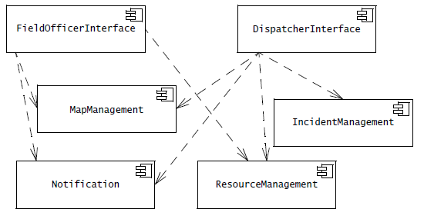
AMS Components and Dependencies – Component Diagram

Slide 9
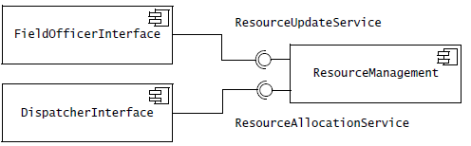
Services and Subsystems – Partial Component Diagram
Ball and Socket Notation

Slide 10
Decision Tracking System (DTS)
Consider a decision tracking system for recording design problems, discussions, alternative evaluations, decisions, and their implementation in terms of tasks. DesignProblem and Option represent the exploration of the design space: we formulate the system in terms of a number of DesignProblem and document each Option they explore. The Criterion class represents the qualities in which we are interested. Once we assessed the explored Options against desirable Criteria, we implement Decisions in terms of Tasks. Tasks are recursively decomposed into Subtasks small enough to be assigned to individual developers. We call atomic tasks ActionItems.

Slide 11
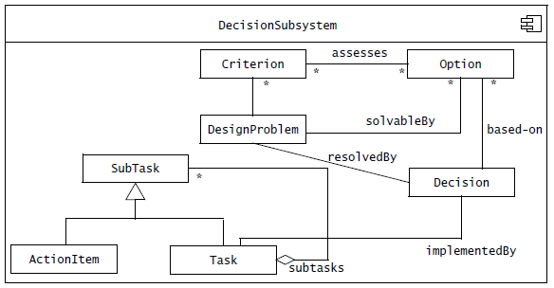
A DTS Subsystem

Slide 12
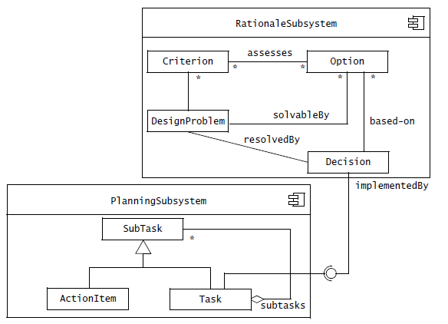
Component Diagram (Internal View)
Better cohesion

Slide 13
Design Methodology (Recap)
We have an abstract description of a solution to our customer’s problem, a software architectural design, a plan for decomposing the design into software units and allocating the system’s functional requirements to them
No distinct boundary between the end of the architecture-design phase and the start of the module-design phase
No comparable design recipes for progressing from a software unit’s specification to its modular design
The process taken towards a final solution is not as important as the documentation produced

Slide 14
Design Methodology (Recap)
Design decisions are periodically revisited and revised
Refactoring
to simplify complicated solutions or to optimize the design

Slide 15
References
SE book by Pfleeger
SE book by Pressman
SE book by Ian Sommerville
OOSE Book by Bruegge

